Slide 1

EDUCATION TO EXCEL SBRR MAHAJANA FIRST GRADE COLLEGE Jayalakshmipuram, Mysore-12
PROJECT TOPIC
“FITNESS THAT FITS”

Slide 2
PROJECT TEAM
Bhavana M S [MCD19010]
Mithun Kaveriappa M K [MCD19046]
UNDER GUIDANCE OF:
Madhura Geetha S
Assistant professor,
Department Of Computer Application,
SBRR MAHAJANA FIRST GRADE COLLEGE

Slide 3
LIST OF CONTENTS
Abstract
Existing System
Proposed System
Disadvantages Of Existing System
Advantages Of Proposed System
Software And Hardware Requirements
System Architecture
Admin Modular Description
User Modular Description
Use Case Diagrams
Dataflow Diagrams
Test Cases
Screenshots
Conclusion
Future Enhancements

Slide 4

ABSTRACT
There is an increasing interest in seeking aid in the Internet to embrace healthier lifestyles. For instance, the rate of Google searches based on keywords such as “fitness”, “gym”, “core” has dramatically increased in the last decade.
Although gyms and leisure centers are a common choice for users who desire to adopt or maintain an active lifestyle, but they are not always within the reach of every person.
Presenting ’Fitness that Fits’, a platform for recommending physical workout videos upon labeled video data from the Youtube-8M dataset.
Our goal is to provide end users with meaningful and diverse workout videos.

Slide 5

EXISTING SYSTEM
Some recommender system aim at supporting health promotion, by recommending physical activity videos.
User can search and watch fitness videos manually.
Expert information is required to gather a relevant dataset of videos, such that multiple experts rate the quality and relevance of the videos, and only those videos are recommended for users.

Slide 6
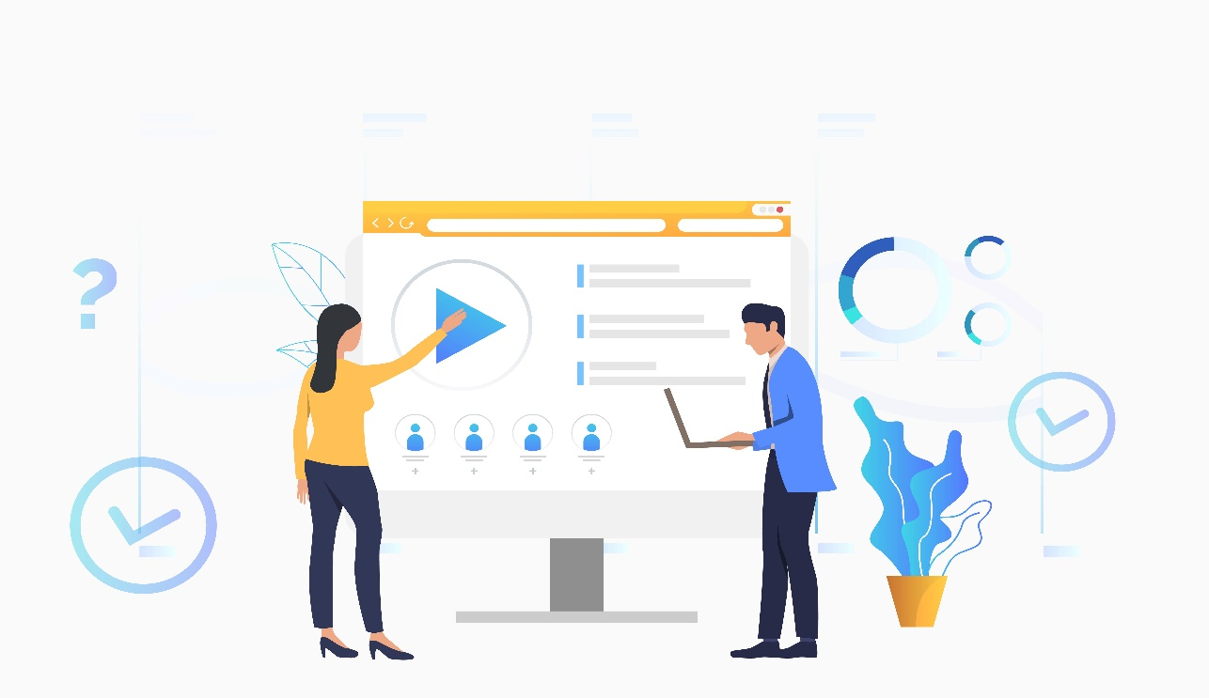
PROPOSED SYSTEM
Platform for recommending physical workout videos upon labeled video data from the Youtube-8M dataset.
In proposed recommender model, fitness videos are recommended totally based on user preferences and their BMI.
Diversified recommendation lists for users to enhance with different types of fitness videos.
Auto recommendation of fitness videos for users.

Slide 7

DISADVANTAGES OF EXISTING SYSTEM
Searching fitness videos manually consumes more time.
Only expert suggested and rated videos are recommended for users.
In Existing system, users have no option for watching videos based on their BMI.
ADVANTAGES OF PROPOSED SYSTEM
Online workout videos are more convenient.
Automatic recommendation of video which saves more time.
Users can watch videos based on their BMI.
Users can watch videos of different category.

Slide 8
SOFTWARE AND HARDWARE REQUIREMENTS
SYSTEM REQUIREMENTS
FRONT END HTML, CSS, BOOTSTRP
MIDDLE LAYER PHP
BACK END MYSQL.
SOFTWARE REQUIREMENTS
OPERATING SYSTEM WINDOWS 8.1 ABOVE
BROWSERS INTERNET EXPLORER, CHROME
HARDWARE REQUIREMENTS
PROCESSOR DUAL CORE (2.0) GHZ OR ABOVE
RAM 1 GB AND ABOVE
HDD 120GB AND ABOVE

Slide 9
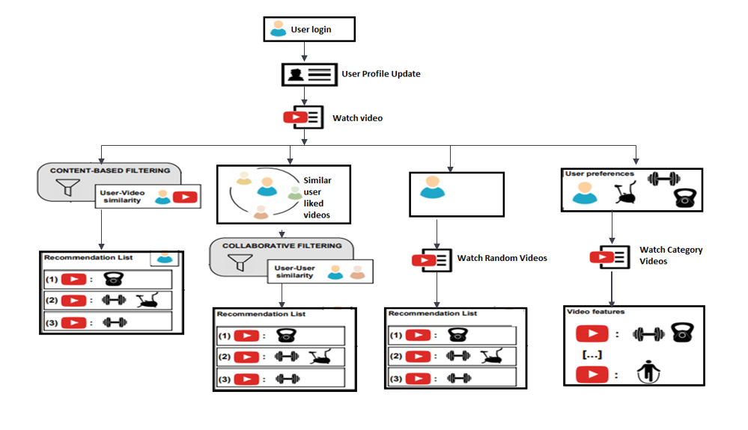
SYSTEM ARCHITECTURE

Slide 10
ADMIN MODULE DESCRIPTION
LOGIN
Admin can login by entering username and password.
VIEW USERS
ADD FOOD
Admin can see users who are logged in to the application.
Admin can add food details and recipe video.
ADD EXPERT
MANAGE FOOD
Admin can add expert, who can update ratings for video
Admin can remove food details from database.
MANAGE EXPERT
UPLOAD DATASETS
Admin can remove expert.
Admin can upload fitness video datasets.
LOGOUT
Admin can logout from application.

Slide 11
USER MODULE DESCRIPTION
LOGIN OR REGISTER
User can login by entering username and password or register to this application.
BASED ON BMI
CATEGORY VIDEOS
User can watch video based on their BMI.
User can watch different categories videos like weight gain, weight loss etc. And also can watch workout videos for different body parts.
SIMILAR USER INTEREST
EXPERT SUGGESTION
User can watch videos liked by similar user who have same BMI value.
User can watch expert suggested video .
RANDOM VIDEOS
DIET PLAN
User can watch random videos under fitness domain.
User can search for healthy food and can add it to their diet plan
LOGOUT
User can logout from application.

Slide 12
system
Login
View users
Add Expert
Manage Expert
Add Food
Admin
Manage Food
Upload dataset
Logout
ADMIN USE CASE DIAGRAM

Slide 13
system
Login
Update profile
View video based on BMI
View Random video
View similar user interest based video
user
View expert suggested video
View category video
View diet plan
Manage diet plan
Logout
USER USE CASE DIAGRAM

Slide 14
system
Login
View video
Update features of video
Expert
Update rating for video
Logout
EXPERT USE CASE DIAGRAM

Slide 15
Authenticate
Database
Admin
Login
Login
Dashboard
Store
Retrieve
-View users
-Add expert
-Manage expert
-Add food
-Manage Food
-Upload dataset
ADMIN DATAFLOW DIAGRAM

Slide 16
Authenticate
Database
User
Login
Login
Dashboard
Store
-Update profile
-Watch video based on BMI
-Watch video based on similar user interest
-Watch Random video
-Watch category video
-View expert suggested video
-View Diet plan
-Manage diet plan
Retrieve
USER DATAFLOW DIAGRAM

Slide 17
Authenticate
Database
User
Login
Login
Dashboard
Store
Retrieve
-View video
-Update features of video
-Update rating for video
EXPERT DATAFLOW DIAGRAM

Slide 18
TEST CASES
Test Case | Test Purpose | Test Condition | Expected Outcome | Actual Result | Pass Or Fail
Login Page | Verify Login page | Enter username And password | Logged in successfully | As Expected | Pass
Register Page | Verify Register Page | Enter username and other details | Should successfully register | Registered Successfully | Pass
User Info | Enter Profile Details | Add profile info | Profile details should store in database | User profile information stored in database | Pass
Liked Video | User can like video by clicking like button | Video info along with BMI value is store in database | Video info and BMI value should store in database | As Expected | Pass
Watch Category Video | User will view the categories | User can select video category and watch video | should display category videos | As Expected | Pass

Slide 19
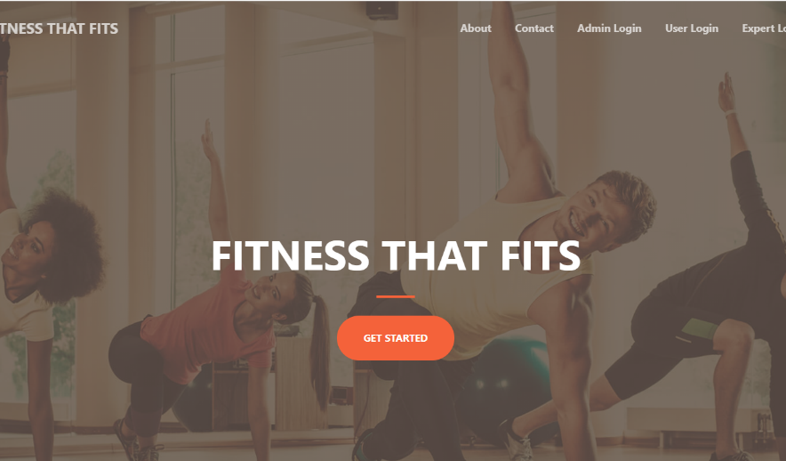
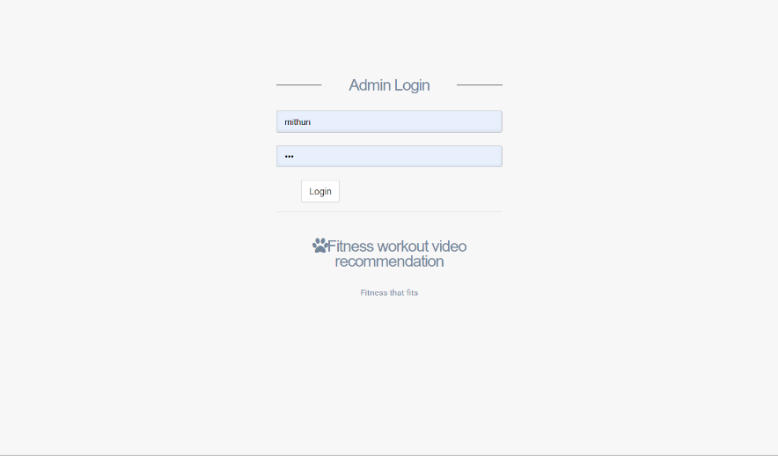
SCREENSHOTS
01
HOME PAGE
02
ADMIN LOGIN PAGE

Slide 20
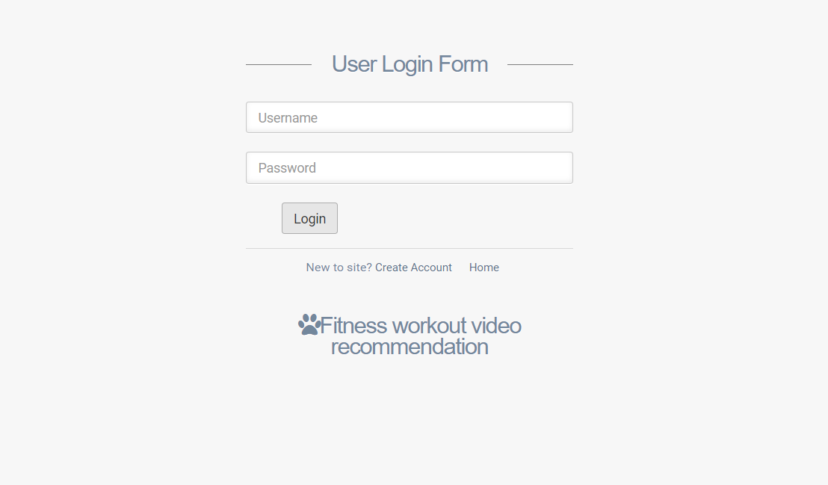
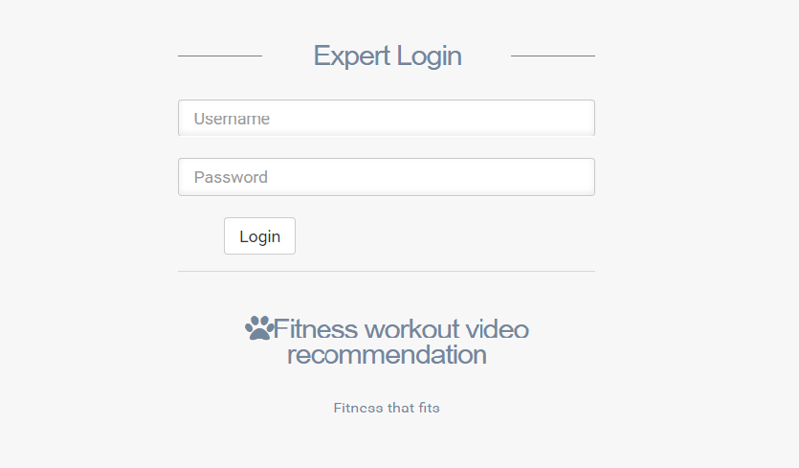
SCREENSHOTS
03
USER LOGIN PAGE
04
EXPERT LOGIN PAGE

Slide 21
CONCLUSION
A platform for recommending bodily exercising videos upon categorized video statistics from the Youtube-8M dataset.
Fitness video recommendation totally based on user profile and their BMI.
Users are provided with different types of fitness videos, which is more relevant and diverse.
Easy to filter videos, which saves more time.

Slide 22
FUTURE ENHANCEMENTS
In Future, we can enhance application by adding different type of parameters.
Mobile app for better communication.
MARKUP: Start out with semantic and well-structured HTML for flexibility and interoperability.
STYLING: Progressively enhance the look-and-feel of a design by adding support for browsers with greater features.
BEHAVIOUR: Enhance the site with rich, interactive features on web browsers with JavaScript.

Slide 23
Thank you
Find us at :
mithunkaveriappa13@gmail.com
bhavanams227@gmail.com

